Slide 1
Lecture 9 Balanced Search Trees
Zonghua Gu (based on Jianchen Shan)
Department of Computer Science
Hofstra University

Slide 2
Lecture Goals
Develop balanced search trees with guaranteed logarithmic performance for search and insert (and many other operations).
We begin with 2-3 trees, which are easy to analyze but hard to implement.
Next, we consider red-black binary search trees, which we view as a novel way to implement 2-3 trees as binary search trees.
Finally, we introduce B-trees, a generalization of 2-3 trees that are widely used to implement file systems.

Slide 3

2−3 Search Trees
The 2-3 tree is a way to generalize BSTs to provide the flexibility that we need to guarantee fast performance
Allow 1 or 2 keys per node
2-node: one key, two children.
3-node: two keys, three children.
Perfect balance: Every path from root to null link has same length.
how to maintain?
Symmetric order: Inorder traversal yields keys in ascending order.
So the search is a generalization of the search in BSTs
Search
Compare search key against keys in node.
Find interval containing search key.
Follow associated link (recursively).
3-node
M
2-node
smaller than E
E J
R
larger than J
Search for H
H is less than M (go left)
Search hit
A C
H
L
P
S X
H is between E and J (go middle)
Search for B
B is less than M (go left)
Search miss
between E and J
null link
B is less than E (go left)
B is between A and C (go middle)
Link is null
3

Slide 4
Insert in 2−3 Search Trees
Insertion into a 2-node at bottom.
Search for key, as usual
Add new key to 2-node to create a 3-node.
Insert K
K is less than M (go left)
K is larger than J (go right)
K is less than L
M
Search ends here and replace 2-node with 3-node containing K
R X
E J
R
Insert Z
Z is larger than M (go right)
A C
K L
Z is larger than R (go right)
H
L
P
S X
S Z
S X Z
S
Z
Z is larger than X
Search ends here
Replace 3-node with temporary 4-node containing Z
Split 4-node into two 2-nodes (pass middle key to parent)
Insertion into a 3-node at bottom.
Add new key to 3-node to create temporary 4-node.
Move middle key in 4-node into parent.

Slide 5
Insert in 2−3 Search Trees (Contd.)
Insertion into a 3-node at bottom.
Add new key to 3-node to create temporary 4-node.
Move middle key in 4-node into parent.
Repeat up the tree, as necessary.
If you reach the root and it's a 4-node, split it into three 2-nodes.
Insert L
L is between E and R (go middle)
Search ends here
Replace 3-node with temporary 4-node containing L
E R
Split 4-node (move L to parent)
H L P
S X
A C
H P
Height of tree increases by 1
L
Split 4-node (move L to parent)
E R
E L R
E
R
A C
H
P
S X
A C
H
P
S X

Slide 6
2−3 Search Trees Construction
Insert S
Create 2-node in the empty tree
Insert H
Convert 3-node into 4-node
Insert E
Convert 2-node into 3-node
Split 4-node into two 2-nodes (move R to parent)
Insert A
Convert 3-node into 4-node
Insert X
Convert 2-node into 3-node
Split 4-node into two 2-nodes (move E to parent)
Insert P
Convert 2-node into 3-node
Insert R
Convert 2-node into 3-node
Insert L
Convert 3-node into 4-node
Insert C
Convert 2-node into 3-node
Split 4-node into two 2-nodes (move R to parent)
Split 4-node into two 2-nodes (move R to parent)
E L R
E R
L
E S
A E S
S
A C
H P
S X
E
R
A
H L P
S
H P
H
A C
H
P
S X
E R
E
E L R
E R
A C
H R S
H S
R S
A
S
Create a new root node. And then the height of the tree grows by one. And that's a legal 2-3 tree, so we stop.
A C
H
P
S X
A
S

Slide 7
Local Transformations in a 2-3 Tree
Converting a 2-node to a 3-node
Converting a three to a four, and then splitting and passing a node up
a e
b c d
only operations we need to consider to get balance.
local transformation: constant number of operations.
less than a
between
a and b
between
b and c
between
c and d
between
d and e
greater than e
Only involves changing a constant number of links, and is independent of the tree size.
a c e
b
d
less than a
between
a and b
between
b and c
between
c and d
between
d and e
greater than e

Slide 8








Global Properties in a 2-3 Tree
Invariants. Maintains symmetric order and perfect balance.
Proof. Each transformation maintains symmetric order and perfect balance.
Splitting a 4-node
root
parent is a 3-node
a b c
b
left
d e
b d e
a
c
a b c
a
c
parent is a 2-node
middle
a e
a c e
left
d
b d
b c d
b
d
a b c
a
c
right
a b
a b d
right
a
a c
c d e
c
e
b c d
b
d
The height doesn’t change. If it is perfect balance before, it is perfect balance afterwards

Slide 9











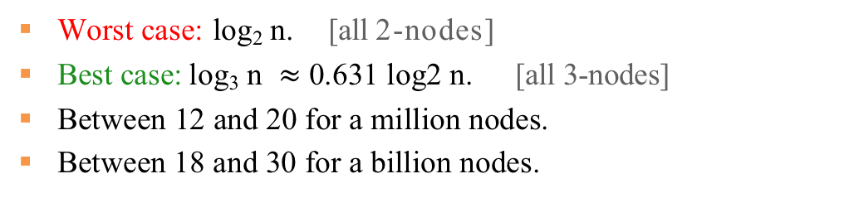
Performance of 2-3 Tree
Perfect balance: Every path from root to null link has same length.
So, that's going to give us, a very easy way to describe a performance.
Operations have costs that's proportional to the path link from root to the bottom.
Tree height
 | Best case | Average case | Worst case
BST | O(1) | O(log n) | O(n)
2-3 Tree | O(1) | O(log n) | O(log n)
Worst case: log₂ n. [all 2-nodes]
Best case: log₃ n $≈$ 0.631 log2 n. [all 3-nodes]
Between 12 and 20 for a million nodes.
Between 18 and 30 for a billion nodes.
2-3 tree model guaranteed logarithmic performance for search and insert.

Slide 10
Lecture Goals
Develop balanced search trees with guaranteed logarithmic performance for search and insert (and many other operations).
We begin with 2-3 trees, which are easy to analyze but hard to implement.
Next, we consider red-black binary search trees, which we view as a novel way to implement 2-3 trees as binary search trees.
Finally, we introduce B-trees, a generalization of 2-3 trees that are widely used to implement file systems.
Red-Black Trees // Michael Sambol
https://www.youtube.com/playlist?list=PL9xmBV_5YoZNqDI8qfOZgzbqahCUmUEin

Slide 11


Red-Black BSTs
Motivation
Direct implementation of 2-3 trees can be done but it is complicated, because:
Maintaining multiple node types is cumbersome.
Need multiple compares to move down tree.
Need to move back up the tree to split 4-nodes.
Large number of cases for splitting.
Red-Black BSTs (Sedgewick 1979): a simple data structure that allows us to implement 2-3 tree with very little extra code beyond the basic BST code.
Left-leaning red-black BSTs (Sedgewick 2007) :
Represent 2–3 tree as a BST.
Use "internal" left-leaning links as "glue" for 3–nodes.
the simplest to implement and at least as efficient
larger key is root
b
3-node
a
a b
greater than b
less than a
between
a and b
greater than b
less than a
between
a and b
Bottom line. Could do it, but there's a better way.

Slide 12




















Left-Leaning Red-Black BSTs
black links connect 2-nodes and 3-nodes
red links "glue" nodes within a 3-node
2-3 tree
M
M
add red link
J
R
E J
R
E
L
P
X
A C H L
P S X
C
H
S
A
corresponding red-black BST
merge red link
horizontal red link
Key property. 1–1 correspondence between 2–3 and LLRB.
M
E
J
R
A C
H
L
P S X
Because the only red links are internal to three nodes.
A BST such that:
No node has two red links connected to it.
Every path from root to null link has the same number of black links.
Red links lean left.
follows directly from the corresponding property for 2-3 trees
"perfect black balance"

Slide 13












Search Implementation for Red-Black BSTs
Observation. Search is the same as for elementary BST (ignore color).
but runs faster because of better balance
public Val get(Key key)
{
Node x = root; while (x != null)
{
int cmp = key.compareTo(x.key);
if(cmp < 0) x = x.left;
else if (cmp > 0) x = x.right;
else if (cmp == 0) return x.val;
}
return null;
We don't have to change the code at all. Our regular search code doesn't examine the color of a link and so we can just use it exactly as is.
M
J
R
E
L
P
X
C
H
S
A
}
Remark. Most other ops (e.g., iteration) are also identical.
We just make sure that we maintain the balance properties during the insertion

Slide 14





Red-Black BST Representation
Each node is pointed to by precisely one link (from its parent)
→ can encode color of links in nodes
→ a node is red if its parent link is red; a node is black if its parent link is black;
private static final boolean RED = true;
private static final boolean BLACK = false;
h.left.color
is RED
h.right.color
is BLACK
private class Node
{
Key key; Value val;
Node left, right;
C
A
h
E
J
D
G
boolean color; // color of parent link
}
private boolean isRed(Node x)
{
if (x == null) return false; return x.color == RED;
}
null links are black

Slide 15

Elementary Red-Black BST Operations
Left rotation. Orient a (temporarily) right-leaning red link to lean left.
rotate E left (before)
h
E
private Node rotateLeft(Node h)
{
assert isRed(h.right); Node x = h.right;
h.right = x.left;
x.left = h;
x.color = h.color;
h.color = RED;
return x;
}
✗
S
x
less than E
✗
between E and S
greater than S
Their black heights are not changed after rotation.
new root to connect the node above
rotate E left (after)
S
x
local operation that only changes a few links
h
E
greater than S
Invariants. Maintains symmetric order and perfect black balance.
less than E
between E and S

Slide 16
Elementary Red-Black BST Operations (Contd.)
Right rotation. Orient a (temporarily) right-leaning red link to lean left.
symmetric code of left rotation
rotate S right (before)
S
h
✗
private Node rotateRight(Node h)
{
assert isRed(h.left); Node x = h.left;
h.left = x.right;
x.right = h;
x.color = h.color;
h.color = RED;
return x;
}
x
E
✗
greater than S
less than E
between E and S
new root to connect the node above
Their black heights are not changed after rotation.
rotate S right (after)
x
E
local operation that only changes a few links
S
h
less than E
Invariants. Maintains symmetric order and perfect black balance.
between E and S
greater than S

Slide 17
Elementary Red-Black BST Operations (Contd.)
Color flip. Recolor to split a (temporary) 4-node and pass up the center node.
flip colors (before)
h
E
private void flipColors(Node h)
{
assert !isRed(h);
assert isRed(h.left); assert isRed(h.right); h.color = RED; h.left.color = BLACK; h.right.color = BLACK;
}
A
S
less than A
between A and E
between E and S
greater than S
flip colors (after)
h
E
local operation that only changes a few links
A
S
Invariants. Maintains symmetric order and perfect black balance.
less than A
between A and E
between E and S
greater than S

Slide 18








Insertion in a LLRB Tree: Overview
Basic strategy. Maintain 1-1 correspondence with 2-3 trees by applying elementary red-black BST operations.
insert C
E
E
A
S
A R S
R
add new node here
corresponding 2-3 tree
right link red so rotate left
E
A
S
C
R
E
E
C
S
A C
R S
A
R
corresponding 2-3 tree

Slide 19

Insertion in a LLRB Tree
Warmup 1. Insert into a tree with exactly 1 node.
left
right
root
root
b
insert a
a
insert b
search ends at this null link
search ends at this null link
root
a
attached new node with red link
b
b
a
root
b
red link to new node containing a
converts 2-node to 3-node
a
rotated left to make a legal 3-node

Slide 20
Insertion in a LLRB Tree
Case 1. Insert into a 2-node at the bottom.
Do standard BST insert; color new link red
If new red link is a right link, rotate left.
to maintain symmetric order and perfect black balance
to restore color invariants
insert C
E
E
A
S
A R S
R
add new node here
corresponding red-black BST
right link red so rotate left
E
A
S
C
R
E
E
C
S
A C
R S
A
R
corresponding red-black BST

Slide 21


























Insertion in a LLRB Tree
Warmup 2. Insert into a tree with exactly 2 nodes.
larger
insert c
smaller
insert a
between
insert b
search ends at this null link
c
c
b
b
a
search ends at this null link
a
search ends at this null link
c
c
a
attached new node with red link
attached new node with red link
b
b
b
c
a
c
a
attached new node with red link
b
a
rotated left
b
rotated right
a
c
b
rotated right
b
colors flipped to black
a
c
a
c
colors flipped to black
b
b
colors flipped to black
a
c
a
c

Slide 22



















Insertion in a LLRB Tree
Case 2. Insert into a 3-node at the bottom.
Do standard BST insert; color new link red.
Rotate to balance the 4-node (if needed).
Flip colors to pass red link up one level.
Rotate to make lean left (if needed).
to maintain symmetric order and perfect black balance
to restore color invariants
insert H
E
two lefts in a row so rotate right
C
S
E
A
R
C
S
R
A
R
E
S
H
C
H
add new node here
A
right link red so rotate left
both children red so flip colors
E
E
C
R
C
R
A
H
S
A
H
S

Slide 23


















Insertion in a LLRB Tree: Passing Red Links up the Tree
Case 2. Insert into a 3-node at the bottom.
Do standard BST insert; color new link red.
Rotate to balance the 4-node (if needed).
Flip colors to pass red link up one level.
Rotate to make lean left (if needed).
Repeat case 1 or case 2 up the tree (if needed).
If the red linke is passed up to a 3-node, we treate it the same way we do at the bottom
insert P
R
both children red so flip colors
E
S
R
C
M
E
S
M
A
H
C
M
both children red so flip colors
E
R
A
H
P
C
H
P
S
add new node here
A
two lefts in a row so rotate right
right link red so rotate left
M
R
R
E
R
E
S
M
S
P
C
M
E
P
C
H
S
A
H
P
C
H
A
A

Slide 24
LLRB Tree Construction Demo
insert S
insert E
insert A
insert R
insert C
insert H
insert X
insert M
two lefts in a row
(rotate S right)
right link red
(rotate A left)
both children red
(flip colors)
E
two lefts in a row
(rotate S right)
S
E
E
C
S
A
S
A
A
R
C
R
H
right link red
(rotate E left)
E
R
right link red
(rotate S left)
R
both children red
(flip colors)
C
R
E
S
E
X
A
H
S
C
H
X
C
H
S
A
A
M

Slide 25
LLRB Tree Construction Demo (Contd.)
insert P
insert L
two lefts in a row
(rotate R right)
R
right link red
(rotate E left)
R
R
E
X
M
X
E
both children red
(flip colors)
X
C
H
S
E
P
S
C
M
S
A
M
right link red
(rotate H left)
A
H
P
C
H
A
both children red
(flip colors)
M
M
E
R
E
R
C
H
P
X
C
L
P
X
A
right link red
(rotate H left)
L
S
A
H
S

Slide 26








Insertion in a LLRB tree: Java implementation
Same code for all cases.
Right child red, left child black: rotate left.
Left child, left-left grandchild red: rotate right.
Both children red: flip colors.
h
left rotate
h
h
right rotate
flip colors
The standard BST code for insertion is in grey
private Node put(Node h, Key key, Value val)
{
if (h == null) return new Node(key, val, RED);
insert at bottom (and color it red)
int cmp = key.compareTo(h.key);
if |  | (cmp | < | 0) | h.left | = put(h.left, | key, | val);
else | if | (cmp | > | 0) | h.right | = put(h.right, | key, | val);
else | if | (cmp | == | 0) | h.val | = val;
if (isRed(h.right) && !isRed(h.left)) h = rotateLeft(h);
if (isRed(h.left) && isRed(h.left.left)) h = rotateRight(h);
if (isRed(h.left) && isRed(h.right)) flipColors(h);
lean left balance 4-node split 4-node
return h;
}
only a few extra lines of code provides near-perfect balance

Slide 27

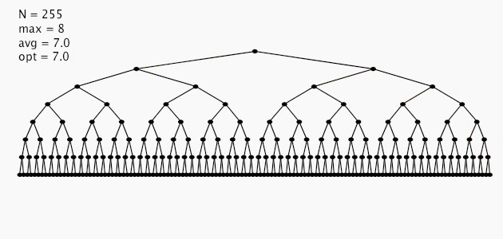

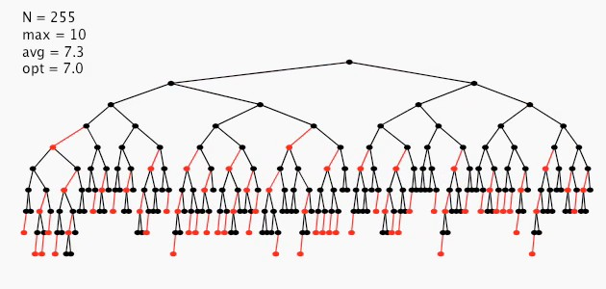

Insertion in a LLRB Tree: Visualization
255 insertions in descending order
255 insertions in ascending order
Height of tree is $≤$2 lg N in the worst case.
Every path from root to null link has same number of black links.
Never two red links in-a-row.
Height of tree is ~ 1.00 lg N in typical applications.
255 random insertions
 | Worst case |  |  | Average case
 | Search | Insert | Delete | Search | Insert | Delete
BST | O(N) |  |  | O(1.39 lg N)
2-3 tree | O(c lg N) |  |  | O(c lg N)
LLRB | O(2 lg N) |  |  | O(1.00 lg N)
constants depend upon implementation
N → number of nodes
max → max number of nodes in a path
avg → average length of a path
opt → minimal length of a path
exact value of coefficient unknown but extremely close to 1

Slide 28
Additional Resources
Left-leaning Red–Black Trees
http://citeseerx.ist.psu.edu/viewdoc/summary?doi=10.1.1.139.282
B-tree
https://www.geeksforgeeks.org/b-tree-set-1-introduction-2/

Slide 29
Lecture Goals
Develop balanced search trees with guaranteed logarithmic performance for search and insert (and many other operations).
We begin with 2-3 trees, which are easy to analyze but hard to implement.
Next, we consider red-black binary search trees, which we view as a novel way to implement 2-3 trees as binary search trees.
Finally, we introduce B-trees, a generalization of 2-3 trees that are widely used to implement file systems.

Slide 30

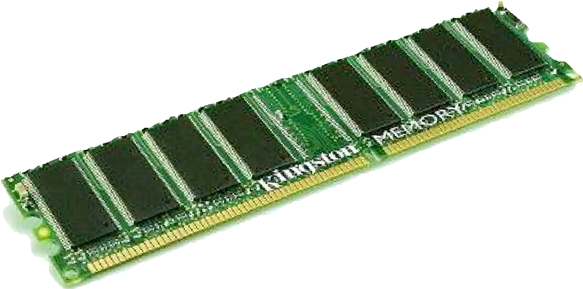
Motivation for B-tree: File system model
Page. Contiguous block of data (e.g., a file or 4,096-byte chunk). Probe. First access to a page (e.g., from disk to memory).
slow
fast
Property. Time required for a probe is much larger than time to access data within a page.
Cost model. Number of probes.
Goal. Access data using minimum number of probes.

Slide 31
B-trees (Bayer-McCreight, 1972)
Generalize 2-3 trees by allowing up to M - 1 key-link pairs per node.
At least 2 key-link pairs at root.
At least M / 2 key-link pairs in other nodes.
External nodes contain client keys.
Internal nodes contain copies of keys to guide search.
Choose M as large as possible so that M links fit in a page, e.g., M = 1024
2-node
K
sentinel key
internal 3-node
each red key is a copy of min key in subtree
D
H
K
Q
U
external 3-node
external 5-node (full)
external 4-node
Q R T U W X Y
B C
D E F
H I J
K M N O P
client keys (black) are in external nodes
all nodes except the root are 3-, 4- or 5-nodes
Anatomy of a B-tree set (M = 6)

Slide 32

Searching in a B-tree
Start at root.
Find interval for search key and take corresponding link.
Search terminates in external node.
searching for E
K
follow this link because
E is between * and K
D
H
K
Q
U
follow this link because
E is between D and H
B C D
E
F
H I J
K M N O P
Q R T
U W X
search for E in this external node
Searching in a B-tree set (M = 6)

Slide 33
Insertion in a B-tree
Search for new key.
Insert at bottom.
Split nodes with M key-link pairs on the way up the tree.
inserting A
H K Q U
B C E F
H I J
K M N O P
Q R T
U W X
H K Q U
A B C E F H I J
K M N O P
Q R T
U W X
new key (A) causes overflow and split
C
H
K
Q
U
new key (C) causes overflow and split
A B
C E F
H I J
K M N O P
Q R T
U W X
K
C
H
root split causes a new root to be created
K
Q
U
A B
C E F
H I J K M N O P
Q R T
U W X
Inserting a new key into a B-tree set

Slide 34
Balance in B-tree
Proposition. A search or an insertion in a B-tree of order M with N keys requires between log _{M-1} N and log _{M/2} N probes.
Pf. All internal nodes (besides root) have between M / 2 and M - 1 links.
In practice. Number of probes is at most 4.
M = 1024; N = 62 billion log M/2 N ≤ 4
Optimization. Always keep root page in memory.

Slide 35
Balanced Trees in the Wild
Red–black trees are widely used as system symbol tables.
Java: java.util.TreeMap, java.util.TreeSet.
C++ STL: map, multimap, multiset.
Linux kernel: completely fair scheduler, linux/rbtree.h.
Emacs: conservative stack scanning.
B-tree variants. B+ tree, B*tree, B# tree, …
B-trees (and variants) are widely used for file systems and databases.
Windows: NTFS.
Mac: HFS, HFS+.
Linux: ReiserFS, XFS, Ext3FS, JFS, BTRFS.
Databases: ORACLE, DB2, INGRES, SQL, PostgreSQL.

